Slide 1
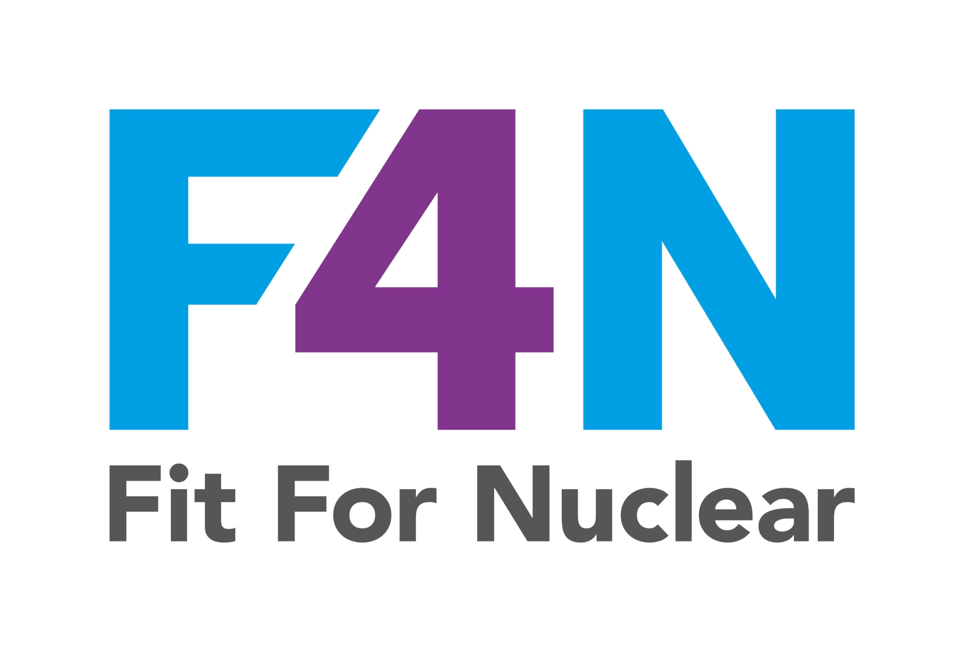

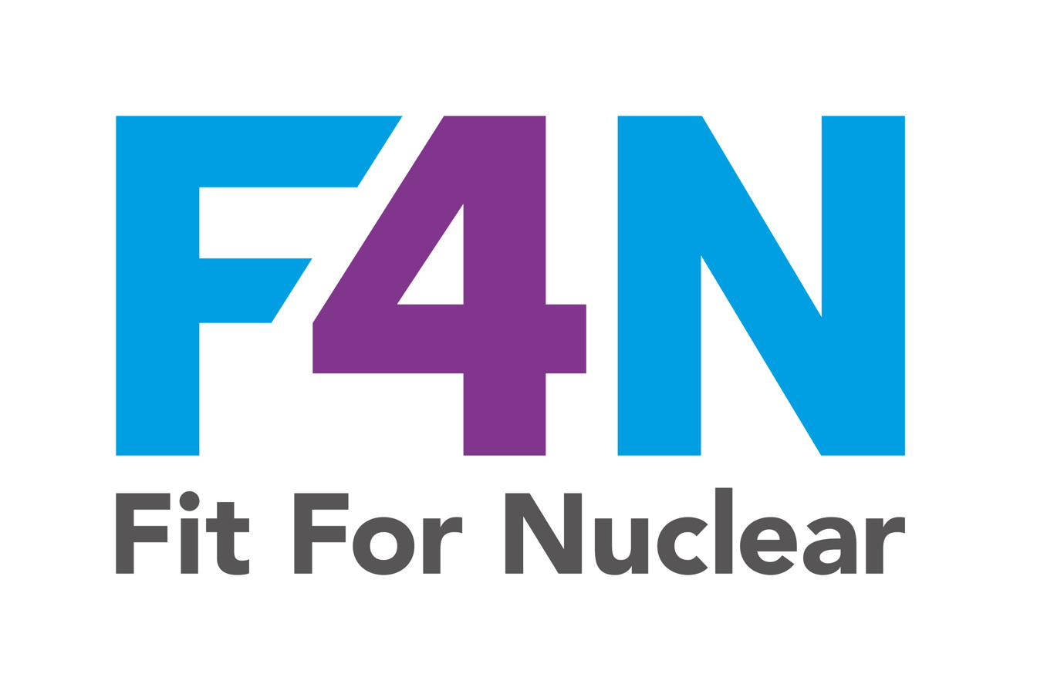





QHSE Training Guide
How to Write a
Risk Assessment
A practical guide to the 5-step HSE process,
risk scoring, control hierarchies and completing
your assessment correctly every time.
Aligned to: HSG65 | ISO 45001:2018 | The Management of Health and Safety at Work Regulations 1999
NucCol | Nuclear Collaboration Ltd · Fit For Nuclear Programme · Commercial in Confidence | 1
Notes:
Title slide. Introduce the guide and its objectives. This training covers the legal framework, the 5-step risk assessment process, risk scoring, hierarchy of controls, and completing a compliant risk assessment form.

Slide 2




Overview
What You Will Learn
Why risk assessment is a legal requirement and what that means for you
The 5 steps of the HSE risk assessment process in full detail
How to identify hazards correctly and who might be harmed
How to score likelihood and severity to calculate a risk rating
The Hierarchy of Controls and how to apply it in the right order
What makes a risk assessment suitable and sufficient under the law
How to review and keep your risk assessments current
NucCol | Nuclear Collaboration Ltd · Fit For Nuclear Programme · Commercial in Confidence | 2
Notes:
Cover all seven learning outcomes. Ask participants to think about their own current risk assessment process before you begin.

Slide 3
Legal Framework
The Legal Duty to Assess Risk
Risk assessment is not optional. It is a statutory requirement under UK law. Employers who fail to carry out suitable and sufficient risk assessments face prosecution, unlimited fines, and imprisonment.
Management of Health and Safety at Work Regulations 1999
Regulation 3 requires every employer to make a suitable and sufficient assessment of the risks to the health and safety of their employees and others affected by their work. The results of any risk assessments with five or more employees must be recorded.
Health and Safety at Work etc. Act 1974
Section 2 places a general duty on employers to ensure, so far as is reasonably practicable, the health, safety and welfare of their employees. Section 3 extends this duty to others who may be affected.
ISO 45001:2018 and HSG65
The international standard for occupational health and safety management systems requires a systematic process for hazard identification and risk assessment. HSG65 provides the UK regulatory guidance framework underpinning this approach.
NucCol | Nuclear Collaboration Ltd · Fit For Nuclear Programme · Commercial in Confidence | 3
Notes:
Stress that 'suitable and sufficient' is the legal test — not perfect, but proportionate to the risk. Five employees trigger the written record requirement. ISO 45001 aligns directly with this legislative framework.

Slide 4
Fundamentals
Hazard vs Risk: Know the Difference
HAZARD
Divider
RISK
Definition:
Definition:
Anything that has the POTENTIAL to cause harm.
The LIKELIHOOD that the hazard will cause harm, combined with the SEVERITY of that harm.
In practice:
In practice:
Examples: a wet floor, rotating machinery, a chemical substance, working at height, a heavy load.
Example: a wet floor (hazard) in a busy corridor with no warning sign = HIGH risk. A wet floor in a locked cupboard = LOW risk.
NucCol | Nuclear Collaboration Ltd · Fit For Nuclear Programme · Commercial in Confidence | 4
Notes:
This is the most important conceptual distinction. Trainees frequently confuse hazard and risk. Use the examples to reinforce. The formula at the bottom underpins all risk scoring.

Slide 5

The Process
The HSE 5-Step Risk Assessment Process
The Health and Safety Executive sets out a clear five-step process for carrying out risk assessments. Every risk assessment in your organisation should follow these steps in order.
▶
▶
▶
▶
Step 1
Step 2
Step 3
Step 4
Step 5
Identify the Hazards
Decide Who Might Be Harmed and How
Evaluate the Risks and Decide on Controls
Record Your Findings
Review and Update
NucCol | Nuclear Collaboration Ltd · Fit For Nuclear Programme · Commercial in Confidence | 5
Notes:
This overview slide gives the full shape of the process. Refer back to it throughout the training. The five steps come directly from HSE guidance 'Five steps to risk assessment' (INDG163).

Slide 6
Step 1 of 5
Identify the Hazards
You cannot control what you have not identified. This step is about systematically finding every hazard associated with the activity or area you are assessing — not just the obvious ones.
How to Identify Hazards
Common Hazard Categories
Walk the area / task route and observe what is actually happening
Physical:
Machinery, noise, vibration, temperature, radiation, moving vehicles
Review accident, incident, and near miss records for the area
Chemical:
Hazardous substances, COSHH, dusts, fumes, gases, solvents
Consult the people doing the job — they know the real hazards
Biological:
Bacteria, viruses, bodily fluids, animal matter
Review manufacturer instructions, Safety Data Sheets, and technical data
Ergonomic:
Manual handling, repetitive movements, DSE, awkward postures
Consider non-routine tasks: maintenance, cleaning, emergencies
Psychological:
Work-related stress, workload, shift patterns, lone working
Think about what happens when things go wrong, not just normal operations
Environmental:
Fire, flooding, electrical systems, working at height, confined spaces
NucCol | Nuclear Collaboration Ltd · Fit For Nuclear Programme · Commercial in Confidence | 6
Notes:
Emphasise that walkthroughs must be done with the task actually being performed, not from a desk. Worker consultation is a legal requirement under the Safety Representatives and Safety Committees Regulations 1977.

Slide 7
Step 2 of 5
Decide Who Might Be Harmed and How
It is not enough to identify the hazard. You must think through who could realistically be harmed and what the mechanism of harm would be. This step forces you to consider people beyond your immediate team.
Employees
Contractors
Operators, maintenance staff, cleaners, supervisors, office workers in adjacent areas
Visiting engineers, maintenance contractors, delivery drivers working on or near the task
Visitors and public
Vulnerable groups
Customers, auditors, members of the public who may be near the workplace
New or young workers, pregnant workers, those with disabilities or health conditions, lone workers
Key question: Who might not be in the area all the time but could pass through, be nearby, or be affected indirectly? Do not limit your thinking to the operator alone.
NucCol | Nuclear Collaboration Ltd · Fit For Nuclear Programme · Commercial in Confidence | 7
Notes:
Vulnerable groups require specific consideration under the Management of Health and Safety at Work Regulations 1999. New and young workers, pregnant workers, and those returning from absence all require individual assessment.

Slide 8
Step 3 of 5
Evaluate the Risks: The Risk Matrix
Once you have identified the hazards and who might be harmed, you need to assess how significant each risk is. We do this by scoring Likelihood and Severity on a scale of 1 to 5, then multiplying them together to produce a Risk Rating.
LIKELIHOOD
SEVERITY
1 – Very Unlikely
Could happen in theory but almost never in practice
1 – Negligible
No injury or minor first aid only
2 – Unlikely
Has happened occasionally across the industry
2 – Minor
Minor injury, no lost time
3 – Possible
Could happen a few times a year in this workplace
3 – Moderate
Injury requiring medical treatment, short lost time
4 – Likely
Happens regularly without intervention
4 – Major
Serious injury, hospitalisation, significant lost time
5 – Almost Certain
Will happen frequently without controls
5 – Catastrophic
Fatality or permanent disability
RISK RATING = Likelihood (1–5) × Severity (1–5) = Score of 1–25
NucCol | Nuclear Collaboration Ltd · Fit For Nuclear Programme · Commercial in Confidence | 8
Notes:
The 5x5 matrix is the most widely used approach. Stress that the score is always Likelihood BEFORE controls x Severity = Initial Risk, then Likelihood AFTER controls x Severity = Residual Risk.

Slide 9
Step 3 of 5
Reading the 5x5 Risk Matrix
1
V.Unlikely
2
Unlikely
3
Possible
4
Likely
5
Certain
LIKELIHOOD →
5
Catastroph.
5
10
15
20
25
1–4 LOW
SEVERITY ↑
Acceptable. Document and monitor.
4
Major
4
8
12
16
20
5–9 MEDIUM
Requires action. Review controls.
3
Moderate
3
6
9
12
15
10–16 HIGH
2
Minor
2
4
6
8
10
Significant action required urgently.
17–25 VERY HIGH
1
Negligible
1
2
3
4
5
Stop the activity. Immediate action.
Score the risk BEFORE controls (initial risk) and AGAIN after controls are applied (residual risk). Both scores must be recorded on the assessment.
NucCol | Nuclear Collaboration Ltd · Fit For Nuclear Programme · Commercial in Confidence | 9
Notes:
Walk through several example scores with the group. A 4x5=20 score before controls should reduce significantly with proper controls in place. The residual risk should always be as low as reasonably practicable.

Slide 10
Step 3 of 5
The Hierarchy of Controls
Controls must be applied in order of effectiveness. You must always start at the top of the hierarchy and work down. PPE is always the last resort — not the first answer.
1. ELIMINATION | Most Effective
Remove the hazard completely. Can the task be redesigned so the hazard no longer exists? Example: automate a manual handling task to remove it entirely.
2. SUBSTITUTION
Replace the hazard with something less dangerous. Example: replace a solvent-based adhesive with a water-based alternative.
3. ENGINEERING CONTROLS
Use physical means to separate people from the hazard. Example: machine guards, LEV extraction, interlocks, enclosed systems.
4. ADMINISTRATIVE CONTROLS
Change the way people work. Example: safe systems of work, permit to work, job rotation to reduce exposure time, training, supervision.
5. PPE | Least Effective
Protect the person as a last resort when all other controls are insufficient. Example: gloves, RPE, eye protection, hearing protection.
NucCol | Nuclear Collaboration Ltd · Fit For Nuclear Programme · Commercial in Confidence | 10
Notes:
The pyramid shape is deliberate — widest at the bottom (PPE) which is the weakest control, narrowest at the top (elimination) which is the strongest. Common mistake: going straight to PPE because it is the easiest option.

Slide 11
Step 3 of 5
Hierarchy of Controls: Manufacturing Examples
Applying the hierarchy in practice — CNC machining swarf ejection hazard:
Elimination
Design parts so swarf is not generated (not always possible — but consider it first)
Substitution
Use a process or material that generates less or finer swarf, reducing ejection risk
Engineering Controls
Full machine enclosure, interlocked guards, automatic swarf conveyors, local exhaust
Administrative
SOP requiring machine door closed during operation; training; supervisor sign-off for setup
PPE
Safety glasses, face shield for setup operations, cut-resistant gloves for swarf removal
NucCol | Nuclear Collaboration Ltd · Fit For Nuclear Programme · Commercial in Confidence | 11
Notes:
Concrete examples make the hierarchy tangible for shopfloor workers and supervisors. Encourage participants to think of examples from their own areas during discussion.

Slide 12


Legal Test
What Does 'Suitable and Sufficient' Mean?
The Management of Health and Safety at Work Regulations 1999 require risk assessments to be 'suitable and sufficient'. This is a legal standard — and it is tested if an incident occurs. It does not mean perfect. It means proportionate, thorough, and documented.
A SUITABLE AND SUFFICIENT Assessment:
Signs of a POOR Assessment:
Identifies all significant hazards relevant to the activity
Lists hazards but offers only 'train employees' as the control
Identifies all the groups who might realistically be harmed
Gives generic controls that could apply to any task in any industry
Evaluates both the initial (pre-control) and residual (post-control) risk
Has no risk scores or scores that have not been genuinely evaluated
Specifies controls that are actually in place and being used
Was completed at a desk without observing the actual task
Is specific enough to be useful — not generic boilerplate
Has not been reviewed since the task, equipment, or people changed
Has been completed by a competent person who knows the task
Is not accessible to the people doing the job
Is dated, signed, reviewed regularly and updated when things change
Residual risk is the same as initial risk — controls have made no difference
NucCol | Nuclear Collaboration Ltd · Fit For Nuclear Programme · Commercial in Confidence | 12
Notes:
This slide is critical for quality of output. Many organisations have risk assessments that would not withstand legal scrutiny. The 'signs of a poor assessment' list comes directly from common HSE enforcement findings.

Slide 13
Step 4 of 5
Record Your Findings: What to Document
If you employ five or more people, you must record the significant findings of your risk assessment. Even where fewer are employed, a written record is strongly recommended as evidence of due diligence.
Activity / Task Description
Hazard Identified
Be specific. 'Workshop operations' is not sufficient. Name the task, the machine, the material, and the location.
State the specific hazard clearly: 'Rotating chuck entanglement' not just 'machinery'.
Who Might Be Harmed
Existing Controls
List the groups: operators, maintenance staff, visitors, etc. Note any vulnerable groups separately.
What controls are already in place before you add any new ones? Guards, PPE, training, procedures.
Initial Risk Score (L x S)
Additional Controls Required
The likelihood and severity score before your additional controls are applied. Record both scores separately.
What further action is needed? Who is responsible and by when? Be specific and achievable.
Residual Risk Score (L x S)
Assessment Date and Review Date
The likelihood and severity score after all controls have been applied. This is your target risk level.
Date completed, name and competence of assessor, and the scheduled review date (or trigger for earlier review).
NucCol | Nuclear Collaboration Ltd · Fit For Nuclear Programme · Commercial in Confidence | 13
Notes:
Walk through a blank risk assessment form at this point and map each column heading to the fields described on this slide. The NucCol Risk Assessment Template covers all of these fields.

Slide 14
Step 5 of 5
Review and Keep Your Assessments Up to Date
A risk assessment is a live document. It must be reviewed whenever there is reason to believe it is no longer valid, and at regular planned intervals. An out-of-date risk assessment provides no legal protection.
Triggers for Immediate Review
Planned Review Schedule
An accident, incident, or near miss occurs related to the task
Low-risk activities
Minimum annually
New equipment, materials, or substances are introduced
Medium-risk activities
Every 6 months or when triggers apply
The task, location, or working method changes significantly
New information becomes available about the hazards involved
High-risk activities
Every 3 months, or on each occasion
A new employee joins the team, particularly a vulnerable group member
Critical activities
Before every instance of the work
Significant changes to legislation or guidance affecting the task
NucCol | Nuclear Collaboration Ltd · Fit For Nuclear Programme · Commercial in Confidence | 14
Notes:
Planned review frequency should reflect actual risk levels. Many organisations default to annual for everything — this is insufficient for high-risk activities. Review schedules should be built into the QHSE calendar.

Slide 15
Competence
Who Should Write a Risk Assessment?
The law requires risk assessments to be carried out by a 'competent person' — someone with sufficient knowledge, training, and experience of the work being assessed. This does not necessarily mean a QHSE professional.
1. Knowledge of the task
2. Understanding of the hazards
The assessor must understand how the work is actually done, including non-routine elements. A risk assessment written purely at a desk by someone who has never done the job will miss critical hazards.
The assessor needs sufficient technical knowledge to identify the full range of hazards. For specialist tasks, a qualified technical expert should be involved.
3. Knowledge of the controls
4. Ability to apply the process
The assessor must know what control measures are available, how effective they are, and whether they are actually being used correctly in practice.
Competence in using the risk scoring system and applying the hierarchy of controls consistently. This is exactly what this training develops.
Best practice: Involve the people who do the job. They know where the real hazards are. The QHSE team can provide the framework and verify the output — but the assessor should be the person closest to the task. Complex or high-risk activities should always have QHSE sign-off.
NucCol | Nuclear Collaboration Ltd · Fit For Nuclear Programme · Commercial in Confidence | 15
Notes:
Competent person is defined in Regulation 7 of the Management of Health and Safety at Work Regulations 1999. There is no requirement for a specific qualification, but the person must demonstrate appropriate knowledge and experience.

Slide 16
Common Mistakes
The 8 Most Common Risk Assessment Mistakes
1
Too generic
2
PPE as the only control
Risks described in vague terms with no specificity to the actual task, workplace, or people involved.
Jumping straight to PPE without working through elimination, engineering, and administrative controls first.
3
No residual score
4
Desk exercise
Recording only the initial risk score without re-evaluating after controls are applied.
Completing the assessment without observing the task being carried out in practice.
5
Never reviewed
6
Controls not verified
Risk assessments that have not been reviewed for years despite changes in people, equipment, or methods.
Listing controls that exist on paper but are not actually being implemented on the shopfloor.
7
Wrong people
8
Not communicated
Assessments written by QHSE staff who do not know the task, without input from the people who do it.
Risk assessments that are filed away but never shared with the workers they are designed to protect.
NucCol | Nuclear Collaboration Ltd · Fit For Nuclear Programme · Commercial in Confidence | 16
Notes:
These eight mistakes come from HSE enforcement experience and are the most common reasons risk assessments fail to protect workers or provide legal protection. Encourage honest self-assessment from the group.

Slide 17
Worked Example
Worked Example: CNC Machining — Swarf Ejection
Activity: CNC turning of steel components. Hazard: Swarf ejection from rotating workpiece or tool.
Who at Risk
Existing Controls
L
S
Initial
Additional Controls
L
S
Residual
Machine operators
Enclosure guard on machine, operator training, SOP in place
3
4
12
Guard interlock check pre-shift, face shield for setup, compressed air prohibited
2
4
8
Maintenance staff
Machine isolated before maintenance (LOTO procedure)
2
4
8
LOTO procedure verified, PPE — face shield during tool change
1
4
4
Visitors / others
Exclusion zone marked, visitors not permitted in machining area without escort
2
4
8
Reinforce exclusion zone with physical barrier during CNC operations
1
4
4
GREEN: 1-4 Low
AMBER: 5-9 Medium
RED: 10+ High/Very High
NucCol | Nuclear Collaboration Ltd · Fit For Nuclear Programme · Commercial in Confidence | 17
Notes:
Walk through this row by row. Show how additional controls reduce the likelihood score but not necessarily the severity — the consequence of contact with swarf remains the same, but the probability of it occurring is reduced.

Slide 18
Nuclear Context
Risk Assessment in the Nuclear Supply Chain
As part of the nuclear supply chain, your risk assessments carry additional weight. Nuclear clients and assessors at F4N verification visits will want to see that your risk management approach is systematic, documented, and genuinely embedded in operations.
Conservative decision-making
Questioning attitude
In the nuclear sector, when in doubt, stop. Risk assessments should reflect this culture: where uncertainty exists about a hazard or its severity, assume the more serious outcome until evidence proves otherwise.
All workers are expected to challenge assumptions. If a risk assessment does not match what is actually happening on the shopfloor, raise it. A document that does not reflect reality is worse than no document.
Personal responsibility
ISO 45001 alignment
Every individual in the supply chain is expected to own their contribution to safety. Risk assessments are not a management exercise — they are a personal commitment to understanding and managing the risks you create.
The F4N assessment expects organisations to be certified to ISO 45001 or working towards it. Your risk assessments form a core part of your occupational health and safety management system under this standard.
NucCol | Nuclear Collaboration Ltd · Fit For Nuclear Programme · Commercial in Confidence | 18
Notes:
This slide connects the general training to the nuclear context. F4N verification assessors will look at risk assessments during the QHSE section of the visit. The key attributes they look for map directly to the nuclear safety culture principles.

Slide 19
Using the Template
How to Use the NucCol Risk Assessment Template
The NucCol Risk Assessment Template is designed to take you through the 5-step process systematically. Each tab in the workbook has a specific purpose.
Tab 1: Cover Sheet
Record the activity details, location, assessor name, date, version number, and next review date. This is your version control record.
Tab 2: Risk Matrix
The colour-coded 5x5 scoring matrix for reference while completing your assessment. Use this to look up risk scores as you work through each hazard.
Tab 3: Risk Assessment
The main working sheet. Complete one row per hazard. Includes hazard, who at risk, existing controls, initial score, additional controls required, and residual score.
Tab 4: Action Tracker
A live action log that pulls forward all additional controls identified. Assign owners and target dates. Close actions off when complete.
Tab 5: Review Log
Record every review of the assessment here: date, reviewer, reason for review, and any changes made. Provides a complete audit trail.
The template and two fully worked examples (CNC machining and welding) are available in the NucCol QHSE resource pack.
NucCol | Nuclear Collaboration Ltd · Fit For Nuclear Programme · Commercial in Confidence | 19
Notes:
At this point, if delivering in person, distribute or screen-share the blank template workbook. Allow 5 minutes for participants to familiarise themselves with the layout before moving to the practice exercise.

Slide 20
PRACTICAL EXERCISE
Complete a Risk Assessment for Your Work Area
Working individually or in pairs, use the NucCol Risk Assessment Template to complete a risk assessment for a task from your own workplace.
Step 1
Choose a specific task from your work area that has known hazards
Step 2
Walk through and identify at least 4 hazards associated with that task
Step 3
For each hazard, identify who might be harmed and how
Step 4
Score the initial likelihood and severity, then identify controls
Step 5
Apply the hierarchy of controls and score the residual risk
Step 6
Record your additional actions with owners and dates
NucCol | Nuclear Collaboration Ltd · Fit For Nuclear Programme · Commercial in Confidence | 20
Notes:
This is the most valuable part of the training. Real assessments from real workplaces generate far more learning than theoretical examples. Allocate 20-25 minutes. Review 2-3 completed assessments as a group, focusing on hazard identification completeness and control hierarchy application.

Slide 21
Summary
Key Messages: What to Remember
01
Risk assessment is a legal requirement. 'Suitable and sufficient' is the test. Document everything.
02
A hazard is what could cause harm. Risk is the likelihood and severity of that harm occurring.
03
Follow the 5 steps: Identify, Who, Evaluate, Record, Review. In that order, every time.
04
Always apply the hierarchy of controls. PPE is the last resort, not the first answer.
05
Record both initial risk and residual risk. Your controls must make a demonstrable difference.
06
Review assessments whenever something changes and at planned intervals. Never let them go stale.
07
Involve the people doing the job. They know the real hazards. The best assessments are collaborative.
NucCol | Nuclear Collaboration Ltd · Fit For Nuclear Programme · Commercial in Confidence | 21
Notes:
Close with this slide. Ask each participant to name the one thing they will do differently as a result of this training. Record their answers for follow-up.

Slide 22
Next Steps
Thank You
1
Download the NucCol Risk Assessment Template from your resource pack
How to Write a Risk Assessment
2
Complete a risk assessment for one activity in your area within 2 weeks
Questions? Speak to your NucCol Supply Chain Consultant or your site QHSE lead.
3
Share your completed assessment with your QHSE lead for review
4
Schedule your first planned review date in the assessment itself
Nuclear Collaboration Ltd
www.nuccol.co.uk
5
Brief your team on the hazards and controls you have identified
enquiries@nuccol.co.uk
Further Resources
linkedin.com/company/nuccol
HSE INDG163: Five steps to risk assessment
HSG65: Managing for Health and Safety
ISO 45001:2018 — Occupational H&S Management
Management of H&S at Work Regulations 1999
NucCol | Nuclear Collaboration Ltd · Fit For Nuclear Programme · Commercial in Confidence | 22
Notes:
Close the session. Allow 10 minutes for open questions. Collect attendance records. Issue action: complete the template exercise within 2 weeks and share with QHSE lead.

